Slide 1
CS1010X Lecture 6:
Higher-order Functions

Slide 2
CS1010X Road Map
Memoization
Java Programming
ADVANCED
Searching & Sorting
Dynamic Programming
Object-Oriented Programming
INTERMEDIATE
Higher-Order Functions
List Processing
Multiple
Representations
BASIC
Functional Abstraction
Data Abstraction
Iteration
Mutation & State
Wishful Thinking
Recursion
Order of Growth
Fundamental concepts of computer programming

Slide 3
The purpose of a program is to perform wonder with just a few statements….
Abstraction is one way…

Slide 4
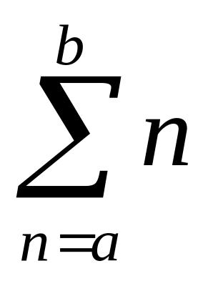
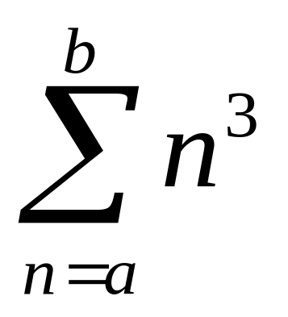

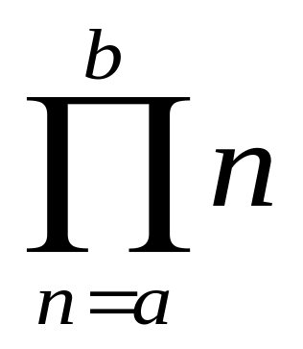
+ of a sequence…
still + …that something is varying differently
same sequence…but symbol is * rather than +

Slide 5
Abstracting common patterns
def sum_integers(a, b):
if a > b:
return 0
else:
return a + sum_integers(a + 1, b)
def sum_cubes(a, b):
if a > b:
return 0
else:
return a*a*a + sum_cubes(a + 1, b)

Slide 6
Abstracting common patterns
def sum_integers(a, b):
if a > b:
return 0
else:
return a + sum_integers(a + 1, b)
Note: 8 * pi_sum = pi
a
def pi_sum(a, b):
if a > b:
return 0
else:
return 1/(a*(a + 2)) + pi_sum(a + 4, b)
b

Slide 7
Abstraction is one way…
Two things to abstract:
Different (next) term
Different operator
(see sum first, later product)
Common pattern:
def <name>(a, b):
if a > b:
return 0
else:
return <term>(a) + <name>(<next>(a), b)

Slide 8
Abstracted as…
def sum(term, a, next, b):
if a > b:
return 0
else:
return term(a) + sum(term, next(a), next, b)
Note that term and next are functions.
So, sum is a higher-order function as it takes some
functions as input too.
Note also that there is a pre-defined function called sum. We are over-writing it.

Slide 9
Abstracted as…
def sum(term, a, next, b):
if a > b:
return 0
else:
return term(a) + sum(term, next(a), next, b)
def sum_integers(a, b):
return sum(lambda x: x,
a,
lambda x: x+1,
b)

Slide 10
Abstracted as…
def sum(term, a, next, b):
if a > b:
return 0
else:
return term(a) + sum(term, next(a), next, b)
def sum_cubes(a, b):
return sum(lambda x: x*x*x,
a,
lambda x: x+1,
b)

Slide 11
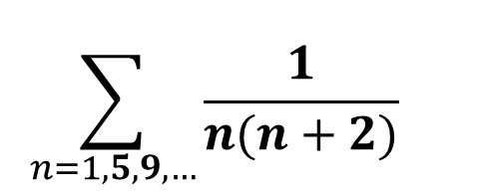
Abstracted as…
def sum(term, a, next, b):
if a > b:
return 0
else:
return term(a) + sum(term, next(a), next, b)
def pi_sum(a, b):
return sum(lambda x: 1/(x*(x+2)),
a,
lambda x: x+4,
b)

Slide 12
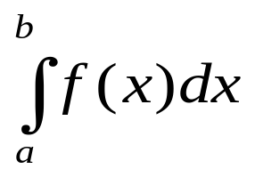
Example 1: Integration
= area under curve
f(x)
a
b

Slide 13
Example 1: Integration
≈ sum of areas of rectangles
f(a+dx/2)
f(x)
a
dx
b

Slide 14
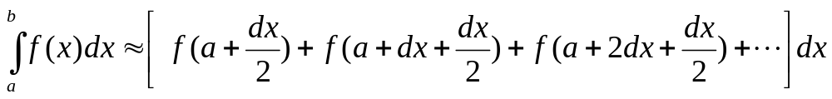
Example 1: Integration
Function as input
def integral(f, a, b, dx):
def add_dx(x):
return x + dx
return dx * sum(f, # term
a + dx / 2, # a
add_dx, # next
b) # b
>>> integral(lambda x: x*x*x, 0, 1, 0.01)
0.24998750000000042
# exact value is 1/4

Slide 15
Example 1: Integration
Function as input
def integral(f, a, b, dx):
return dx * sum(f, # term
a + dx / 2, # a
lambda x: x + dx, # next
b) # b
>>> integral(lambda x: x*x*x, 0, 1, 0.01)
0.24998750000000042
# exact value is 1/4

Slide 16
Key idea
sum captures a common pattern
The other functions:
sum_integers,
sum_cubes,
pi_sum, &
integral
are special cases of sum.
more examples….

Slide 17
More Higher-Order Functions Examples
Besides functions as Input,
a higher order function actually
outputs / manipulates
(higher order) functions

Slide 18
Functions may be returned as values from other functions.
>>> def make_x(x):
return lambda : x
>>> five = make_x(5)
>>> eight = make_x(8)
>>> x = 10
>>> five
>>> five()
5
>>> eight
>>> eight()
8
<function ..>
Must understand whether the return value of a function is another function or a number or some other object
<function ..>
Notes:
Not in video – self trying.

Slide 19
Example 2: Derivative
Function as output
In math, the derivative of g(x) is
Derivative transforms a function into another function.
def deriv(g):
dx = 0.00001
return lambda x: (g(x+dx)-g(x))/dx

Slide 20
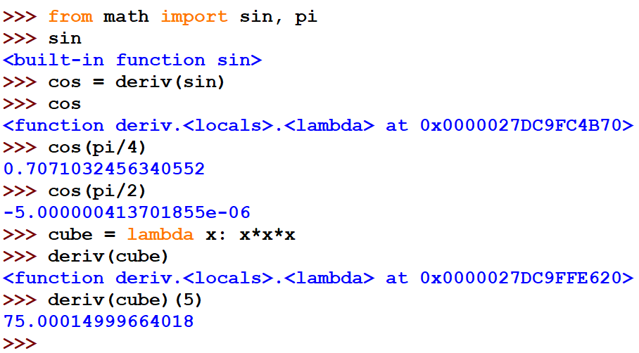
Example 2: Derivative
Notes:
We don’t want to do `from math import *` because we want to define our own cos. Explicit is better implicit.

Slide 21
Example 3: Newton’s method
Use of derivative
To compute root of function g(x),
i.e. find x such that g(x) = 0
Start with initial guess x₀
x ← x₀
If g(x) ≈ 0 then stop with answer is x
x ← x – g(x)/Dg(x)
Go to step 3

Slide 22
Example 3: Newton’s method
def newtons_method(g, first_guess):
Dg = deriv(g)
def new_guess (x):
return x - g(x)/Dg(x)
def is_close_enough(v):
return abs(v) < 0.0001
def attempt(guess):
if is_close_enough(g(guess)):
return guess
else:
return attempt(new_guess(guess))
return attempt(first_guess)
Start with initial guess x₀
x ← x₀
If g(x) ≈ 0 then stop with
answer is x
x ← x – g(x)/Dg(x)
Go to step 3

Slide 23
Example 4: Computing Square Root
Use of Newton’s method
Square root of a is the number x s.t:
x² = a
Use Newton’s method to solve:
g(x) = x² – a

Slide 24
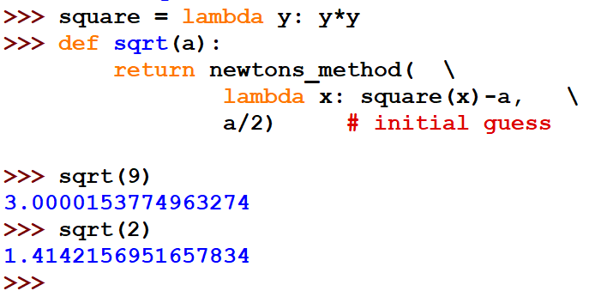
Example 4: Computing Square Root

Slide 25
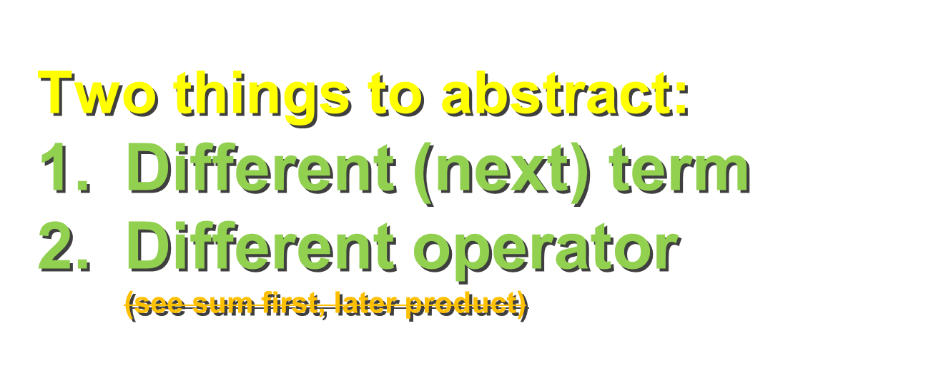
Abstraction is one way…
…move on to address product from sum, or rather generic operator +

Slide 26
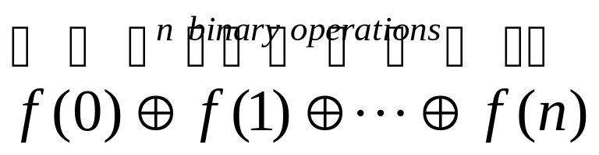
Example 5: fold
Compute , for some function f, by applying binary operator ⊕ till f(n).
def fold(op, f, n):
if n==0:
return f(0)
else:
return op(f(n), fold(op, f, n-1))

Slide 27
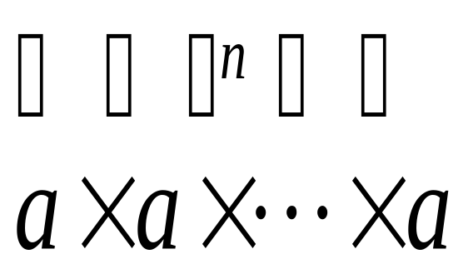
Usage of fold #1: expt
fold:
expt:
def expt(a,n):
return fold(lambda x,y: x*y,
lambda x: a,
n-1)
fold(op, f, n)
n-1
lambda x: a
lambda x,y: x*y

Slide 28
Usage of fold #2: sum_of_digits(n)
Suppose sum_of_digits(n) returns the sum of the digits in n.
(e.g. n=3124, answer: 10)
def sum_of_digits(n):
return fold(lambda x,y: x+y, # op
lambda k: kth_digit(n,k), # f
count_digits(n)-1) # n
Question:
How do we define kth_digit and count_digits?
fold(op, f, n)

Slide 29
Usage of fold #3: sum / product
fold(op, f, n)
def product_of_digits(n):
# e.g. n=3124, answer: 3 x 1 x 2 x 4 = 24
return fold(lambda x, y: x * y,
lambda k: kth_digit(n,k),
count_digits(n)-1)
def sum_of_sqrt_of_digits(n):
# e.g. n=494, answer: 2 + 3 + 2 = 7
return fold(lambda x, y: x + y,
lambda k: sqrt(kth_digit(n,k)),
count_digits(n)-1)

Slide 30

Abstraction is one way…
3. Many more “ingredients” that we can find as long as they make sense…

Slide 31
Recap: Sum of Integers
Consider the following code to sum all integers in the range a to b
def sum_integers(a,b):
return sum(lambda x: x,
a,
lambda x: x+1,
b)

Slide 32
Recap: Product of Integers
We can have the following code to multiply
all integers in the range a to b
def product_integers(a,b):
return product(lambda x: x,
a,
lambda x: x+1,
b)
What’s this??

Slide 33
Definition of sum:
    def sum(term, a, next, b):
    if a > b:
    return 0
    else:
    return term(a) +
    sum(term, next(a), next, b)
Definition of product:
    def product(term, a, next, b):
    if a > b:
    return 1
    else:
    return term(a) *
    product(term, next(a), next, b)

Slide 34
Example 6: fold2 a more general fold
def fold2(op, term, a, next, b, base):
if a > b:
return base
else:
return op (term(a),
fold2(op, term, next(a), next,
b, base))
def sum(term, a, next, b):
return fold2(lambda x,y: x+y, term, a, next, b, 0)
def product(term, a, next, b):
return fold2(lambda x,y: x*y, term, a, next, b, 1)
abstract as parameters in higher-order function

Slide 35
Summary
Python functions are first-class objects.
They may be:
  named by variables,
  passed as arguments to functions, or
  returned as the results of functions.
Higher-order functions capture common programming patterns

Slide 36
term
a
sum
value
next
b
term
a
product
value
next
b
Try:
How would you define factorial in terms of product?
How would you define expt in terms of product?

Slide 37
op
fold
g
term
assume from 0 to n
n
op
term
g
fold2
a
allow from a to b
next
b
base

Slide 38
Applications
f
a
integral
value
b
dx
g
deriv
Dg
g
newton
value
guess

Slide 39

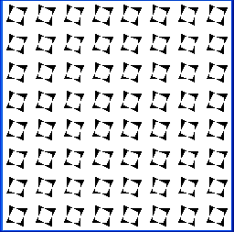
Repeating multiple times
make_cross
4 times
def repeat_pattern(n, pat, pic):
if n == 0:
return pic
else:
return pat(repeat_pattern(n-1, pat, pic))
>>> show(repeat_pattern(4, make_cross, nova_bb))
function

Slide 40
n
repeat_
pattern
pat
pic
pic
make them equivalent
Homework:
n
repeat_
pattern
npat
pat
pic
npat
pic
pic
npat
pic

Slide 41
Please DO NOT memorize the definitions of sum, product, fold, fold2, etc.

Slide 42
Required Competencies
Understand how to use higher-order functions to define specific functions
Understand how to define higher-order functions by abstracting patterns

Slide 43
CS1010X is NOT about memory work; it is about UNDERSTANDING.

Slide 44
CS1010X is NOT about answers; it is about PROCESS.

